Slide 1
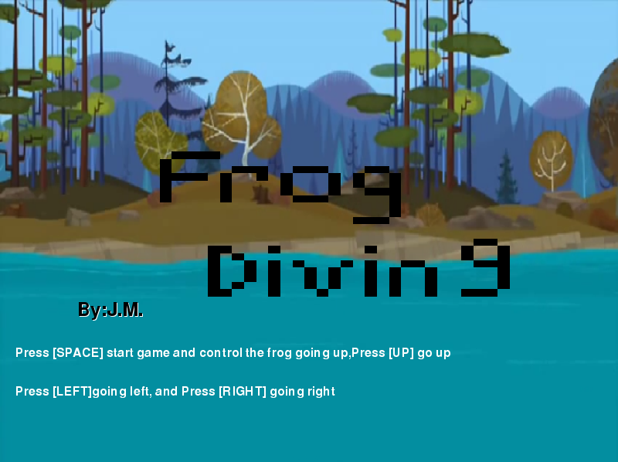
Notes:
Company: J.M.
By: Mengting Chen & Jenny Zhang

Slide 2
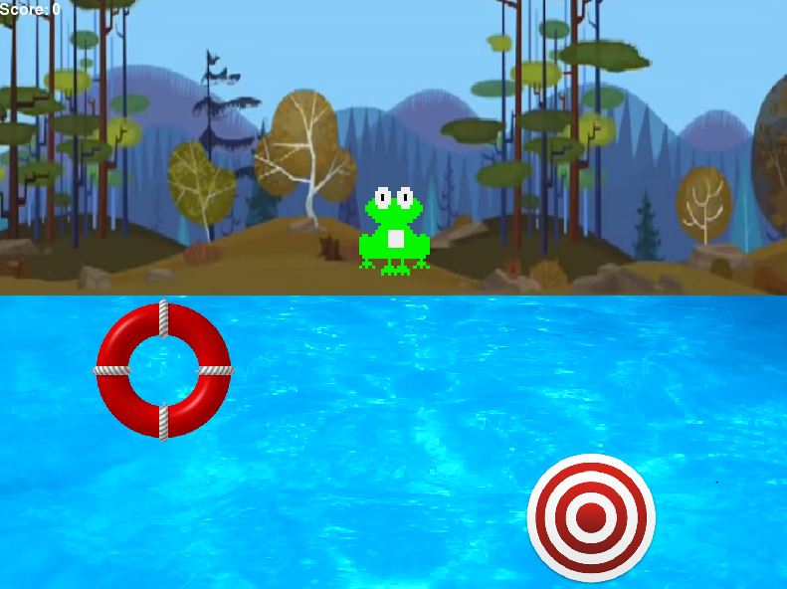
Notes:
The objective of the game is the frog, target, pool, and obstacle circle.

Slide 3
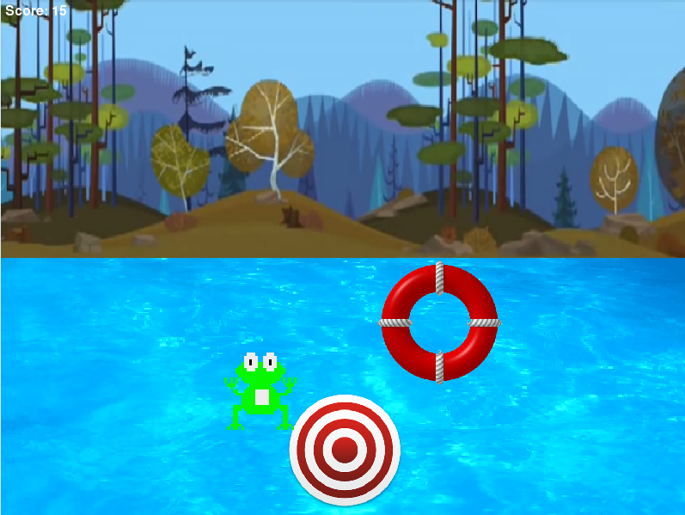
Notes:
Challenges is we have obstacles in the game, the obstacle is the circle, it has
scroller in the pool to obstructed frogmove to attack target.

Slide 4
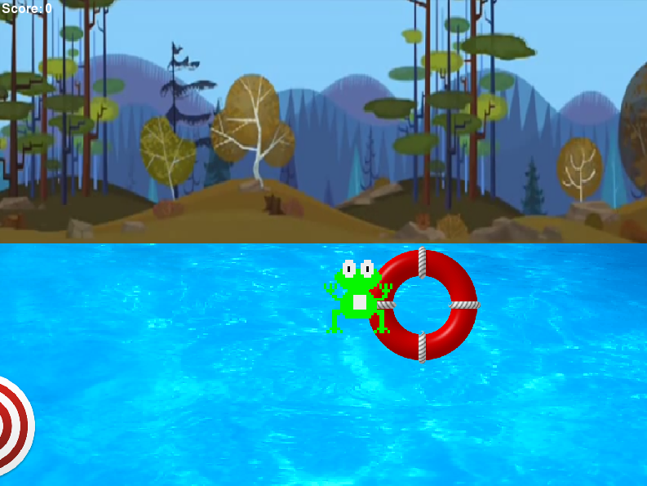
Notes:
If frog touch the circle you lose!

Slide 5
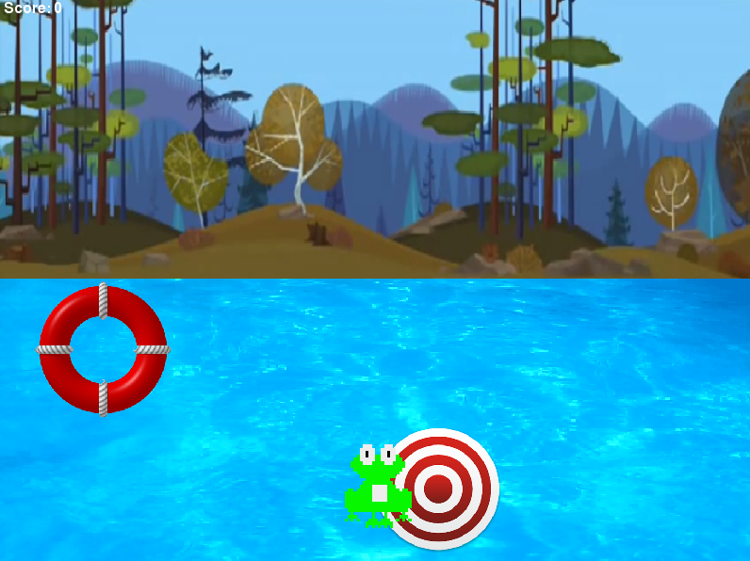
Notes:
If frog touch the circle you win!

